Slide 1
McGregor 2022 vs McGregor 2023
Culture Values Assessment Results
December 2023

Slide 2
CULTURE describes “the way things work around here”
ENGAGEMENT describes “how people feel about the way things work around here.”

Slide 3
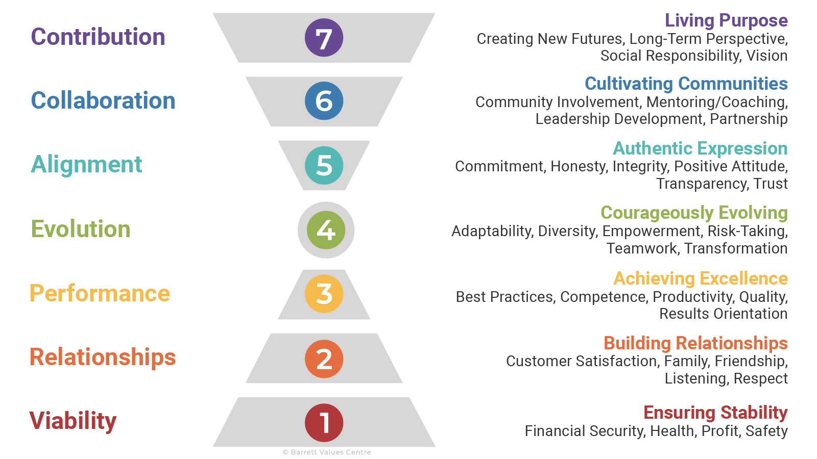

Slide 4
Assessment Questions
Personal Values
Please select ten of the following values/behaviors that most reflect who you are, not who you desire to become.
Current Culture Values
Please select ten of the following values/behaviors that most reflect how this organization currently operates.
Desired Culture Values
Please select ten of the following values/behaviors that you would desire for this organization to achieve its highest potential (or performance).
Includes Diversity, Equity and Inclusion

Slide 5
Overall Organization Results

Slide 6
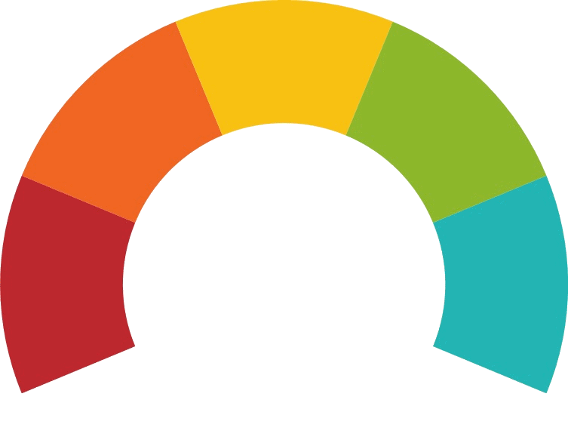
CULTURE VALUES ASSESSMENT RESULTS
Cultural Comparison Summary
McGregor 2022 vs. McGregor 2023
Culture Score
Personal/Current Culture Matches
Current/Desired Culture Matches
Cultural Entropy®
Balance Index
■ Foundation ■ Evolution ■ Impact
McGregor 2022
349 Participants
McGregor 2023
371 Participants
56
71
3
5
5
6
20%
19%

Slide 7
CULTURE VALUES ASSESSMENT RESULTS
Summary of Results
McGregor 2023
371 participants
Alignment
Cultural Entropy® Score
Balance Index
Personal & Current Culture Matches
0%—13%
14%—19%
20%—28%
29%+
5
Very Good
People are able to bring themselves to work.
Current & Desired Culture Matches
Needing Attention
19%
6
Good
Group is on the right track.
Organizational Perspectives
Potentially Limiting Values
New Values to Focus On
Process
People
Purpose
2
Some element of fear behind how decisions are made or how people are managed
coaching/ mentoring
continuous improvement
customer satisfaction
respect
control
confusion
CC 19%
DC 21%
CC 45%
DC 51%
CC 17%
DC 23%

Slide 8
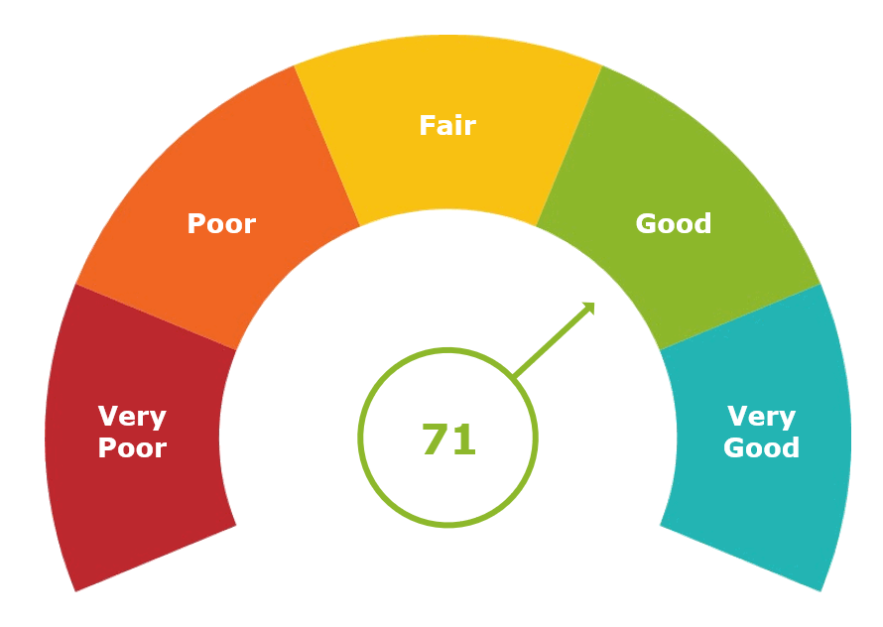
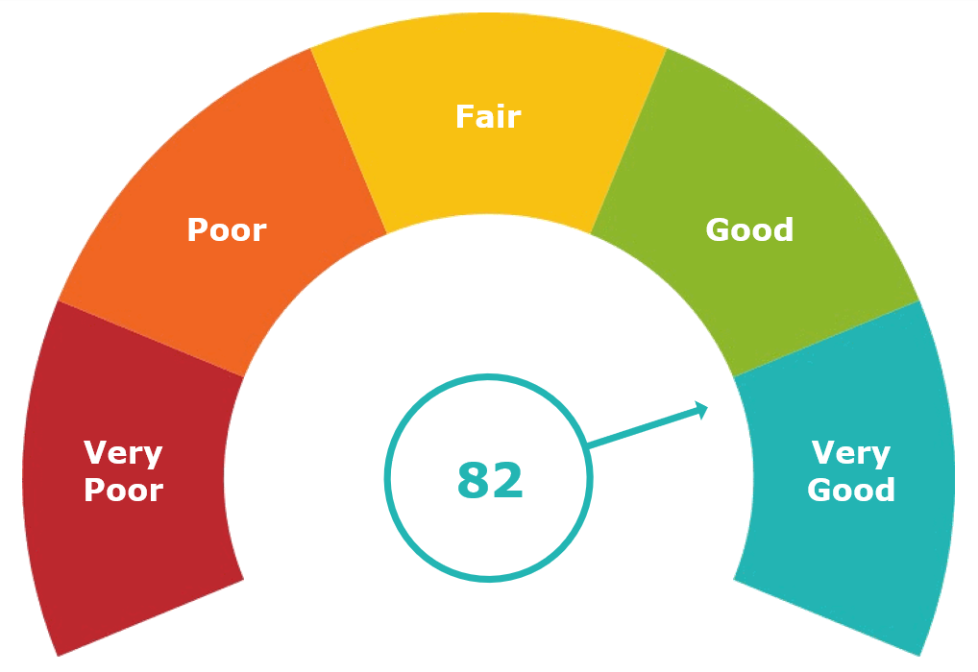
CULTURE VALUES ASSESSMENT RESULTS
Culture Score Comparison
McGregor PACE 2022 vs. McGregor PACE 2023
This is the benchmark metric reflecting the health and strength of a culture. The score is based on matches, Cultural Entropy® and balance between the levels.
McGregor PACE 2022 196 participants | McGregor PACE 2023 174 participants
Global Average: 51
Drive Average: 64

Slide 9
CULTURE VALUES ASSESSMENT RESULTS
Cultural Comparison Summary
McGregor PACE 2022 vs. McGregor PACE 2023
 | McGregor 2022 196 Participant | McGregor 2023 174 Participant
Culture Score
Personal/Current Culture Matches | 4 | 4
Current/Desired Culture Matches | 5 | 6
Cultural Entropy®
Potentially Limiting Values | 1 | 0
Balance Index
■ Foundation ■ Evolution ■ Impact
14%
14%

Slide 10
Overall Group Results
PACE
174 participants
Personal Values (PV)
Current Culture Values (CC)
Desired Culture Values (DC)
Contribution Collaboration Alignment Evolution Performance Relationships Viability
VALUE | VOTES |  | LEVEL
accountability |  | 107 | 4
caring |  | 90 | 2
compassion |  | 70 | 7
honesty |  | 63 | 5
adaptability |  | 54 | 4
hard working |  | 53 | 3
empathy |  | 44 | 6
ambition |  | 42 | 3
balance (home/work) |  | 41 | 4
respect |  | 41 | 2
VALUE | VOTES |  | LEVEL
teamwork |  | 56 | 4
caring |  | 50 | 2
accountability |  | 47 | 4
diversity |  | 43 | 4
balance (home/work) |  | 41 | 4
compassion |  | 38 | 7
employee recognition |  | 38 | 2
employee engagement |  | 33 | 5
making a difference |  | 33 | 6
coaching/ mentoring |  | 32 | 6
VALUE | VOTES |  | LEVEL
accountability |  | 81 | 4
coaching/ mentoring |  | 49 | 6
teamwork |  | 48 | 4
continuous improvement |  | 46 | 4
balance (home/work) |  | 43 | 4
caring |  | 42 | 2
commitment |  | 37 | 5
positive attitude |  | 34 | 5
achievement |  | 33 | 3
employee recognition |  | 33 | 2
professionalism |  | 33 | 3
respect |  | 33 | 2
Positive Value
Potentially Limiting
PV & CC 1 Match
PV & DC 1 Match
CC & DC 3 Matches
PV, CC & DC 3 Matches

Slide 11
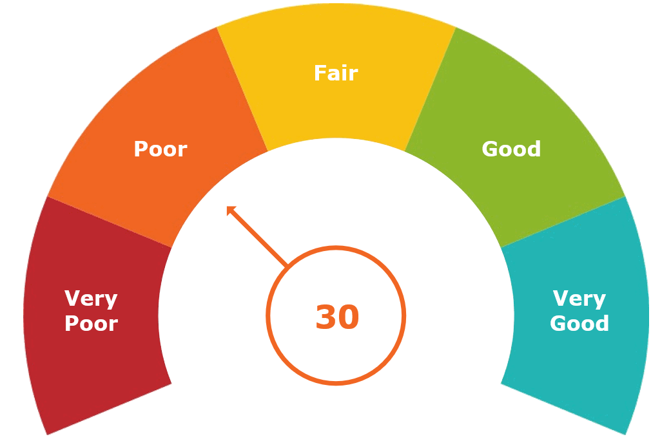
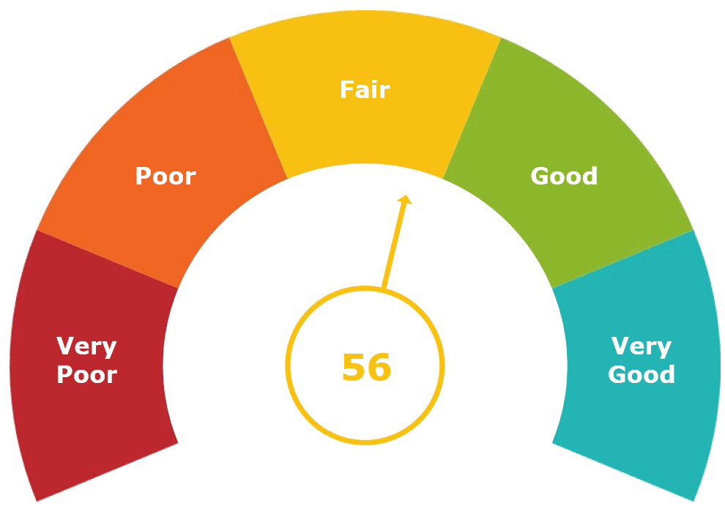
CULTURE VALUES ASSESSMENT RESULTS
Culture Score Comparison
McGregor Residential Housing 2022 vs. McGregor Residential Housing 2023
This is the benchmark metric reflecting the health and strength of a culture. The score is based on matches, Cultural Entropy® and balance between the levels.
Residential Housing 2022 153 participants | Residential Housing 2023 197 participants
Global Average: 51
Drive Average: 68

Slide 12
CULTURE VALUES ASSESSMENT RESULTS
Cultural Comparison Summary
McGregor Residential Housing 2022 vs. McGregor Residential Housing 2023
 | Residential Housing 2022 153 Participant | Residential Housing 2023 197 Participant
Culture Score
Personal/Current Culture Matches | 3 | 4
Current/Desired Culture Matches | 2 | 5
Cultural Entropy®
Potentially Limiting Values | 5 confusion, blame, bullying, control, cost reduction | 3 control, blame, confusion
Balance Index
■ Foundation ■ Evolution ■ Impact
27%
23%

Slide 13
CULTURE VALUES ASSESSMENT RESULTS
Overall Group Results
Residential Housing
197 participants
Personal Values (PV)
Current Culture Values (CC)
Desired Culture Values (DC)
Contribution Collaboration Alignment Evolution Performance Relationships Viability
VALUE | VOTES |  | LEVEL
accountability |  | 110 | 4
caring |  | 109 | 2
compassion |  | 75 | 7
hard working |  | 67 | 3
ambition |  | 65 | 3
honesty |  | 60 | 5
commitment |  | 52 | 5
adaptability |  | 51 | 4
balance (home/work) |  | 44 | 4
respect |  | 44 | 2
VALUE | VOTES |  | LEVEL
caring |  | 71 | 2
accountability |  | 53 | 4
control |  | 49 | 1
diversity |  | 44 | 4
employee recognition |  | 44 | 2
blame |  | 43 | 2
commitment |  | 40 | 5
compassion |  | 40 | 7
confusion |  | 39 | 3
teamwork |  | 38 | 4
VALUE | VOTES |  | LEVEL
accountability |  | 111 | 4
caring |  | 68 | 2
continuous improvement |  | 58 | 4
coaching/ mentoring |  | 50 | 6
balance (home/work) |  | 49 | 4
compassion |  | 48 | 7
teamwork |  | 48 | 4
commitment |  | 44 | 5
customer satisfaction |  | 44 | 2
respect |  | 43 | 2
Positive Value
Potentially Limiting
PV & CC 0 Matches
PV & DC 2 Matches
CC & DC 1 Match
PV, CC & DC 4 Matches

Slide 14
Values Jumps
McGregor 2023
371 participants
Values
CC
DC
Jump
Types of Jumps
accountability |  | 100 | 192 | 92
continuous improvement |  | 63 | 104 | 41
coaching/ mentoring |  | 63 | 99 | 36
clarity |  | 36 | 67 | 31
positive attitude |  | 31 | 62 | 31
trust |  | 24 | 55 | 31
professionalism |  | 38 | 68 | 30
honesty |  | 46 | 74 | 28
leading by example |  | 20 | 48 | 28
information sharing |  | 25 | 50 | 25
Existing In CC and DC now Call to strengthen
New Values In Desired Culture
Emerging Not in Desired Culture

Slide 15
Next Steps
Communicate status back to all team members
Departments will create a 3 x 3 to address three areas for improvement based on results

